Slide 1
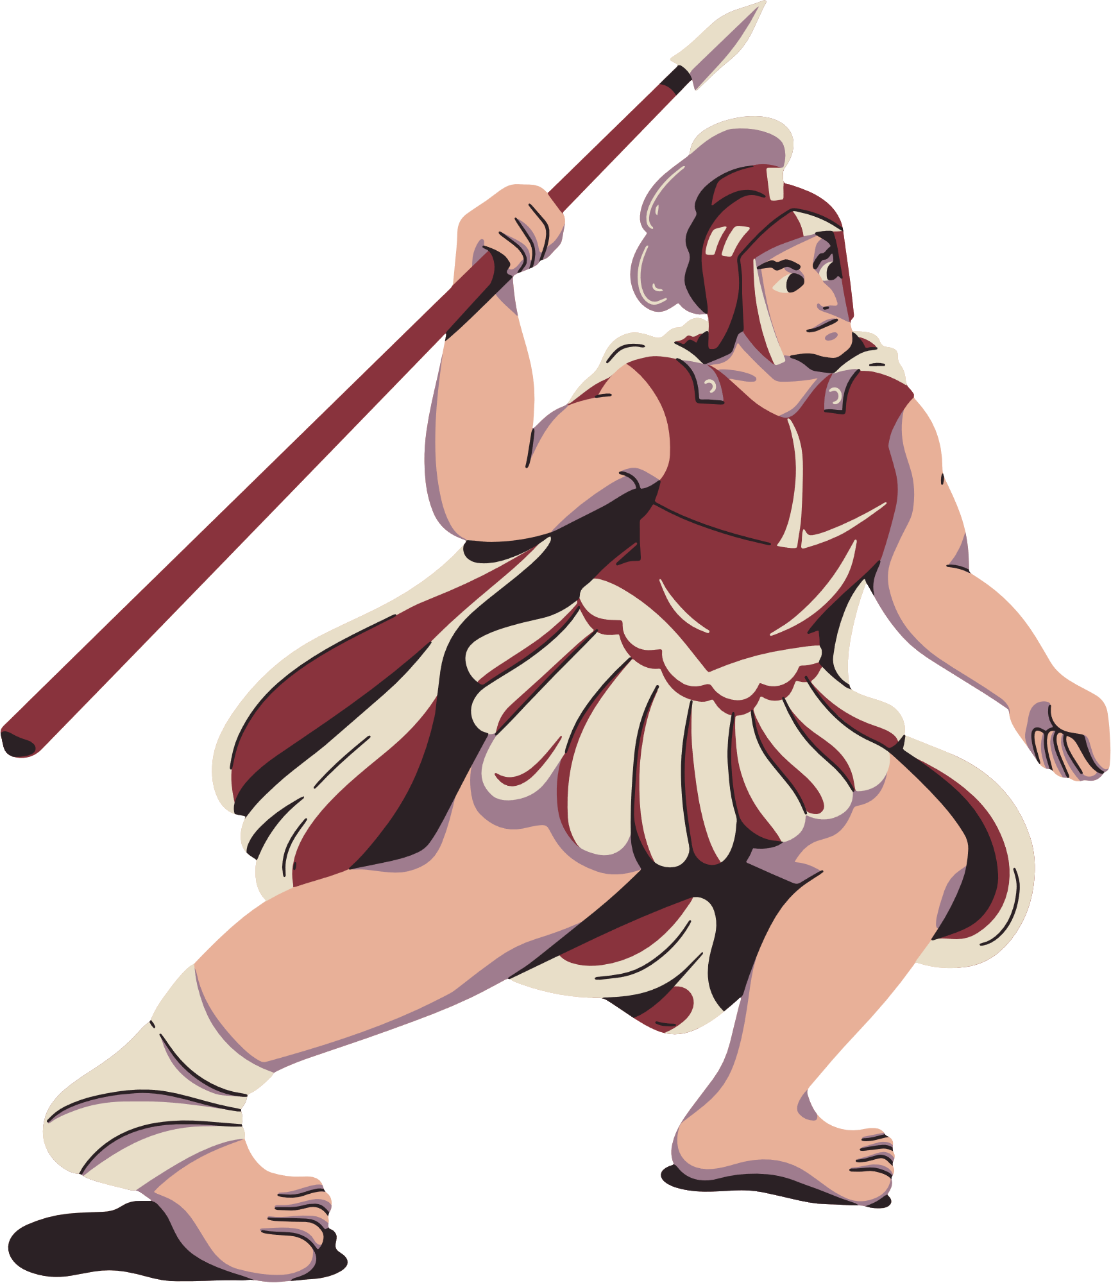






Sports and nutrition management

Slide 2

team members
01
2310030366
V Nikhil Chandra
02
2310030322
N Charan Reddy
03
2310030291
G Sai Krishna Reddy
04
2310030353
K Sai Dheeraj Goud

Slide 3






Objective
The Sports and Nutrition Management Website aims to provide aspiring athletes and sports enthusiasts with a personalized training experience tailored to their chosen sport. The platform will offer customized workout plans, allowing users to enhance their skills and performance in sports like football, volleyball, and cricket.
Additionally, the website will generate personalized diet plans based on the user’s selected sport, training intensity, and fitness goals to ensure optimal nutrition and recovery.
To keep users informed and engaged, the website will regularly update with the latest sports news, strategies, and rules, helping athletes stay ahead in their game. With an intuitive and stylish interface, the platform will serve as a one-stop solution for sports training, nutrition guidance, and staying updated on evolving sports trends.

Slide 4

Aim
The Sports and Nutrition Management Website aims to create a comprehensive digital platform that empowers athletes and sports enthusiasts with personalized training programs and customized nutrition plans based on their chosen sport, skill level, and training intensity.
The project seeks to enhance athletic performance by integrating expert-designed workouts, strategic sports insights, and the latest industry news in one accessible space. By providing up-to-date sports strategies, rules, and trends, gameplay. Through a user-friendly and visually engaging interface, the website aspires to be a go-to resource for individuals striving for excellence in their respective sports while maintaining a balanced and effective nutrition plan.

Slide 5




thank you

